Slide 1
Chapter 3
Image Transform: Frequency Domain Representation and Enhancement 10 CO3
3.1 Introduction , DFT and its properties, radix-2 algorithm(2- DFT ), FFT algorithm: divide and conquer approach, Dissemination in Time(DIT)-FFT
3.2 Discrete Cosine Transform, Walsh Transform, Hadamard Transform, Haar Transform, Principal component Analysis(PCA/Hoteling Transform), Introduction to Wavelet Transform
3.3 Low Pass and High Pass Frequency domain filters: Ideal, Butterworth,
Homomorphic filter
Self-Learning Topic: Discrete Sine Transform (DST)

Slide 2
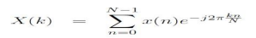
Discrete Fourier Transform
Discrete fourier transform for a finite sequence is given by:
Evaluating summation for finite sequence for 0 to N-1.
k/N corresponds to frequency F
N corresponds to time for discrete signals

Slide 3
Discrete Fourier Transform
Magnitude function
X(k) = √Xr^2(k)+Xi^2(k)
Phase function
Angle X(k)=tan-1[Xi(k)/Xr(k)]

Slide 4
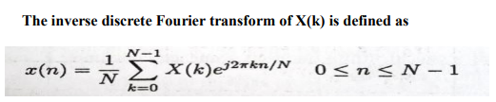
Inverse Discrete Fourier Transform

Slide 5
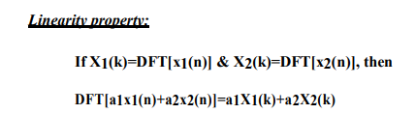
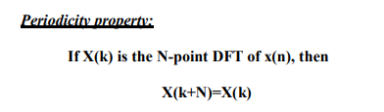
Properties of DFT

Slide 6
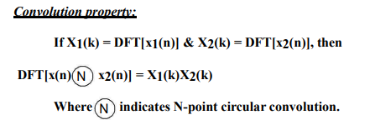
Properties of DFT
DFT of circular convolution of two sequences is equivalent to product of their individual DFTs.

Slide 7
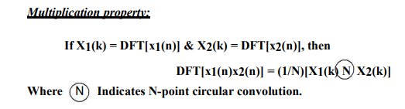
Properties of DFT
DFT of product of two discrete time sequences is equivalent to circular convolution of DFTs of individual sequences scaled by factor of 1/N.

Slide 8
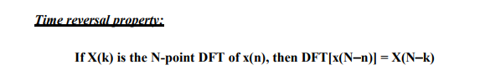
Properties of DFT
Reversing the N point sequence in time is equivalent to reversing the DFT sequence.

Slide 9
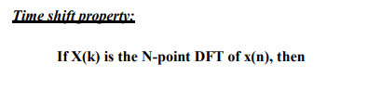
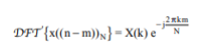
Properties of DFT
The circular time shift property of DFT says that if discrete time signal is circularly shifted in time by m units , then its DFT is multiplied by e^-j2pikm/N

Slide 10
Properties of DFT
Conjugation
DFT of complex conjugate of any sequence is equal to complex conjugate of DFT of that sequence , with sequence delayed by k samples in frequency domain.
DFT{x(n)}=X(k)
DFT{X*(n)}=X*(N-k)

Slide 11
Fast Fourier Transform
FFT is method of computing DFT with reduced number of calculations.
Computational efficiency is achieved if we adopt a divide and conquer approach.
Approach is based on decomposition of N point DFT into successively smaller DFTs.

Slide 12
Radix-2 FFT
N=2^m
m is number of stages
N point sequence is decimated into 2 point , further from a 2 point sequence 4 point DFT can be computed and so on.

Slide 13
Phase or Twiddle Factor
Complex valued factor in DFT is defined as WN
also called as twiddle factor.
Twiddle factor is given as
W = e^(-j2*pi)
Twiddle factor can be multiplied or divided by any integer.

Slide 14
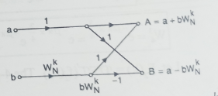
DIT-FFT
Steps to find DFT using Radix 2 DIT FFT:

Slide 15
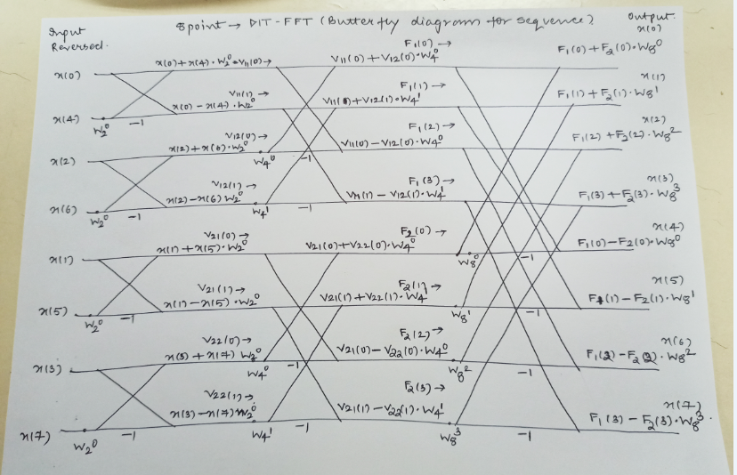

Slide 16
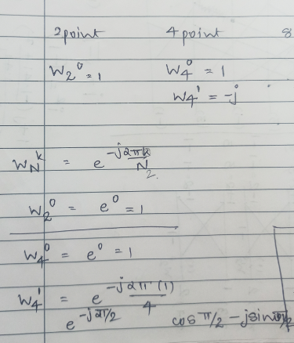

Slide 17
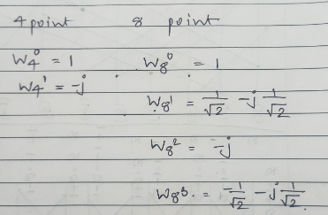

Slide 18
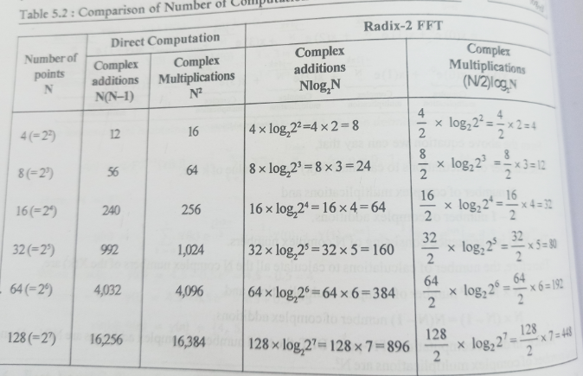

Slide 19
Image Transforms
Image transforms are extensively used in image processing and image analysis.
Transform is basically a mathematical tool, which allows us to move from one domain to another domain (time domain to the frequency domain).
migrate from one domain to another domain is to perform the task at hand in an easier manner.

Slide 20
Image Transforms
Image transforms are useful for fast computation of convolution and correlation.
The transforms do not change the information content present in the signal.
Transforms play a significant role in various image-processing applications such as image analysis, image enhancement, image filtering and image compression.

Slide 21
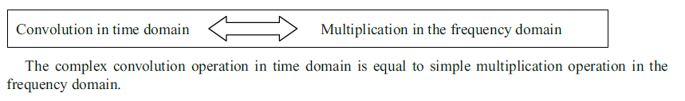
NEED FOR TRANSFORM
Mathematical Convenience

Slide 22
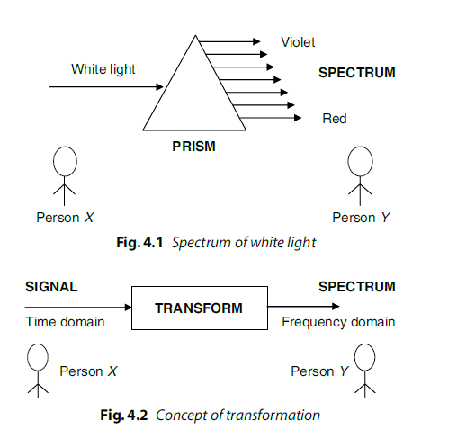
NEED FOR TRANSFORM

Slide 23
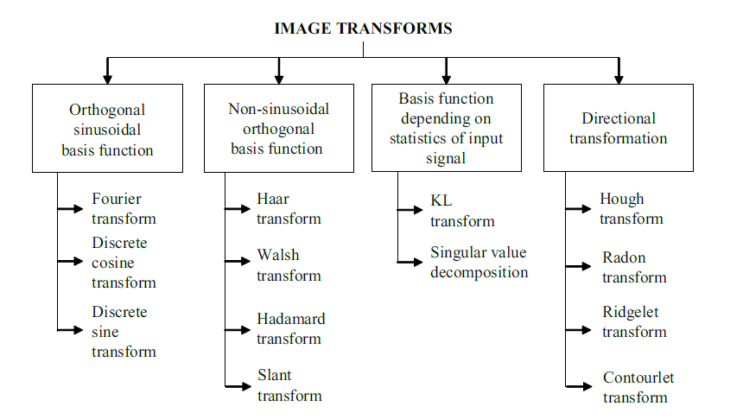

Slide 24
Image Transform
1) Orthogonal sinusoidal basis function
One of the most powerful transforms with orthogonal sinusoidal basis function is the Fourier transform.
The transform which is widely used in the field of image compression is discrete cosine transform.

Slide 25
Image Transform
2) Non-sinusoidal orthogonal basis function
The transforms whose basis functions are non-sinusoidal in nature.
One of the important advantages of wavelet transform is that signals (images) can be represented in different resolutions.

Slide 26
Image Transform
3) Basis function depending on statistics of input signal
The transform whose basis function depends on the statistics of input signal are KL transform and singular value decomposition.
The KL transform is considered to be the best among all linear transforms with respect to energy compaction.

Slide 27
Image Transform
4) Directional transformation
The transforms whose basis functions are effective in representing the directional information of a signal include Hough transform, Radon transform, Ridgelet transform and Contourlet transform.

Slide 28
Need for transform
The need for transform is most of the signals or images are time domain signal (ie) signals can be measured with a function of time.
This representation is not always best.
For most image processing applications anyone of the mathematical transformation are applied to the signal or images to obtain further information from that signal.

Slide 29
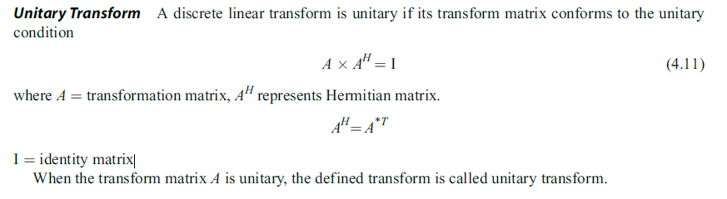

Slide 30
Orthogonal DFT
If A is unitary and has only real elements , then it is orthogonal matrix
A is orthogonal if A.A’ = I

Slide 31
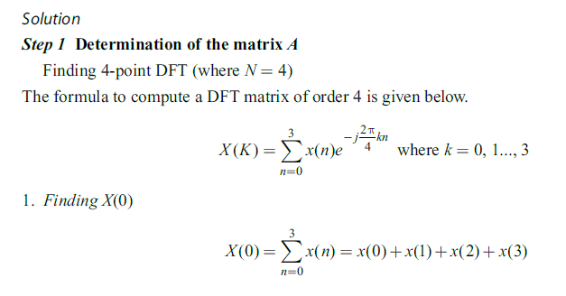
Image Transform
1) Check whether the DFT matrix is unitary or not.

Slide 32
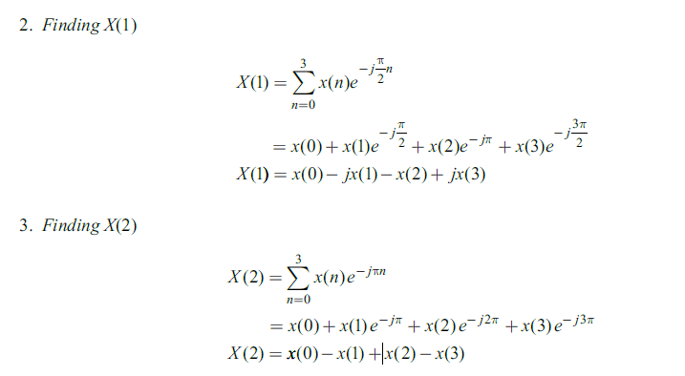

Slide 33
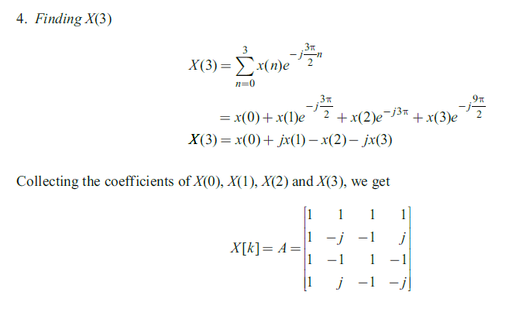

Slide 34
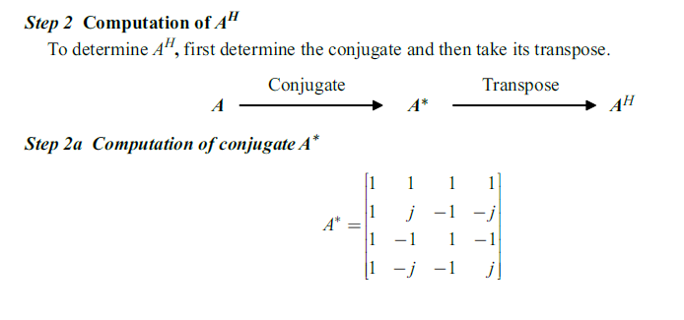

Slide 35
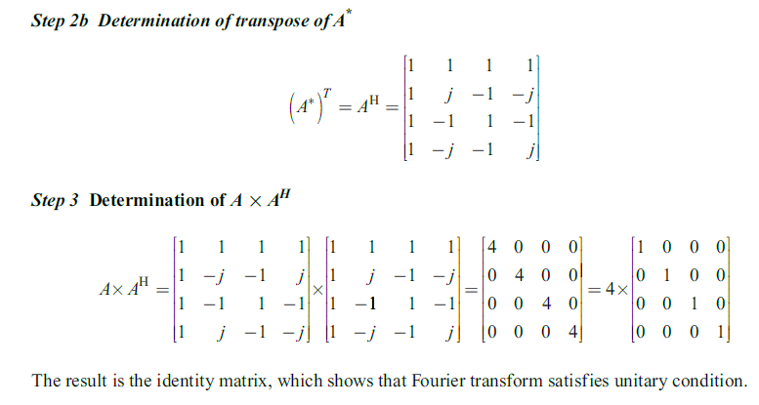

Slide 36
Unitary Transform
unitary transformation preserves the signal energy
Most unitary transforms pack a large fraction of the energy of the image into relatively few of the transform coefficients.
Few of the transform coefficients have significant values and these are the coefficients that are close to the origin

Slide 37
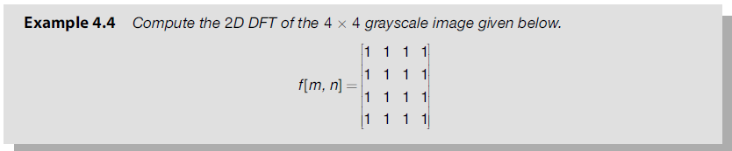
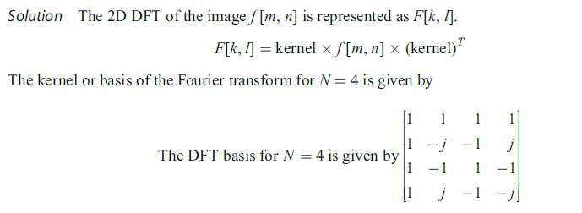
DFT of Image Matrix (2D)

Slide 38
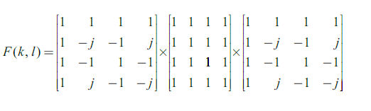
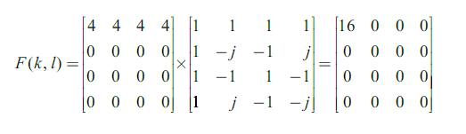
DFT of Image Matrix (2D)

Slide 39
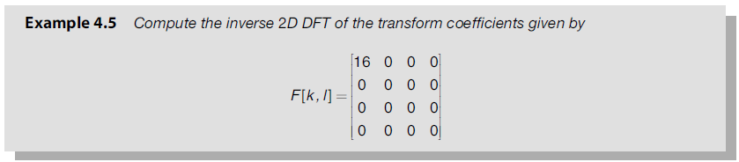

Slide 40
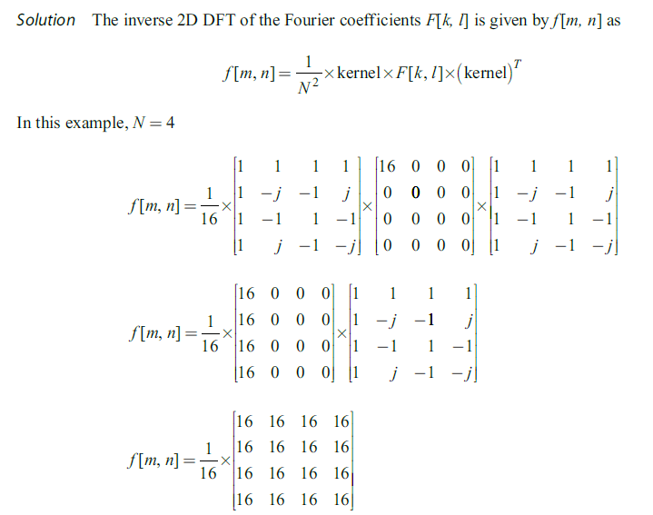

Slide 41
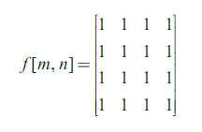

Slide 42
Discrete Cosine Transform (DCT)
The discrete cosine transforms are the members of a family of real-valued discrete sinusoidal unitary transforms.
A discrete cosine transform consists of a set of basis vectors that are sampled cosine functions.
DCT is a technique for converting a signal into elementary frequency components and it is widely used in image compression.

Slide 43
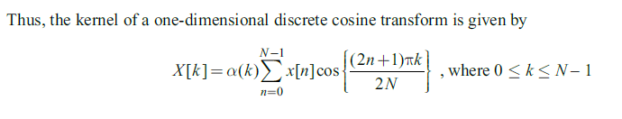
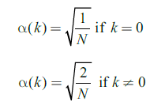

Slide 44
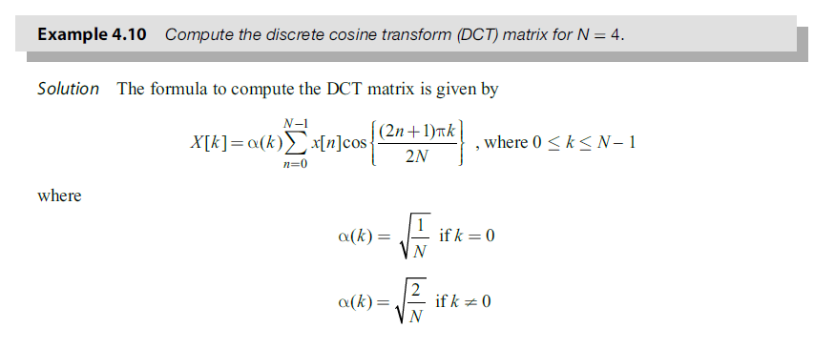

Slide 45
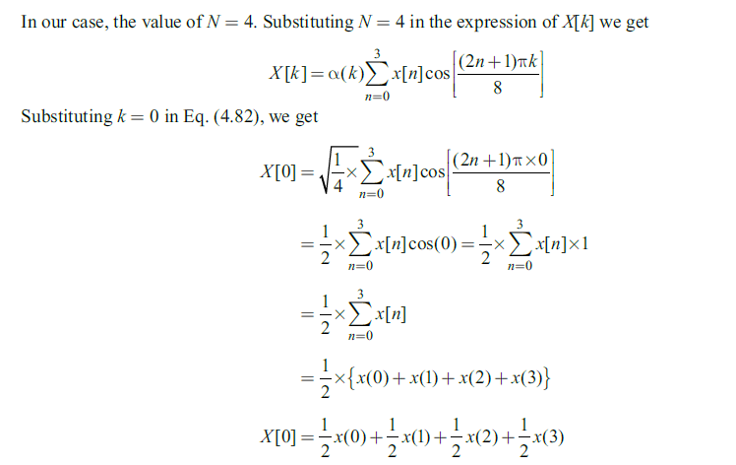

Slide 46
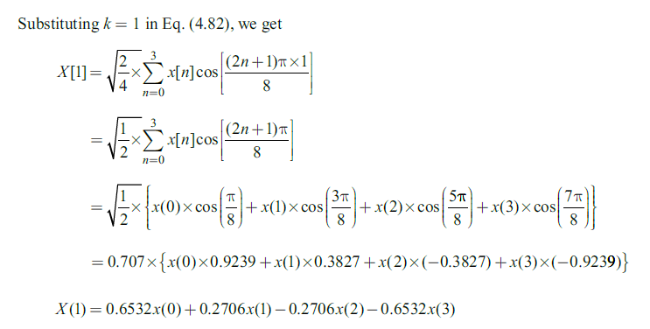

Slide 47
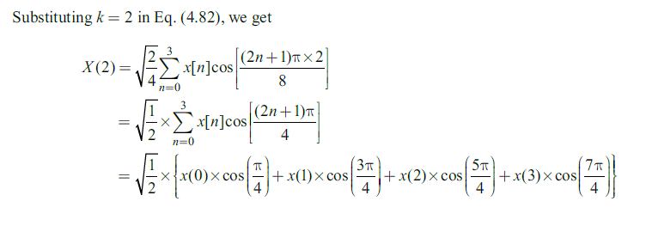
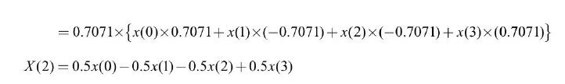

Slide 48
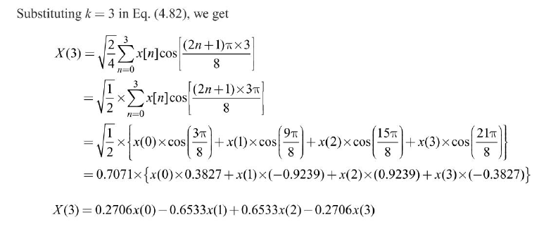

Slide 49
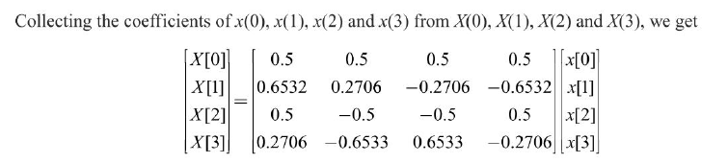

Slide 50
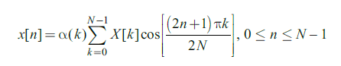
IDCT

Slide 51
Symmetric and Asymmetric
Transformation Matrix – T
Image Matrix – f
If Transformation matrix is symmetric:
F = TfT
If Transformation matrix is asymmetric:
F = TfT’

Slide 52
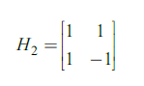
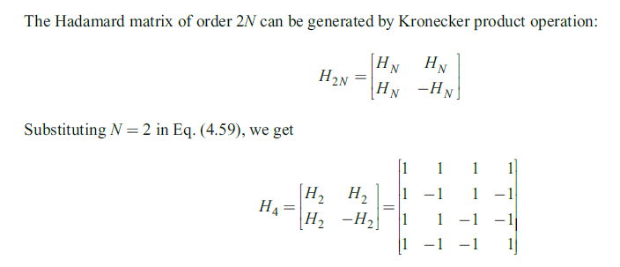
Hadamard Transform

Slide 53
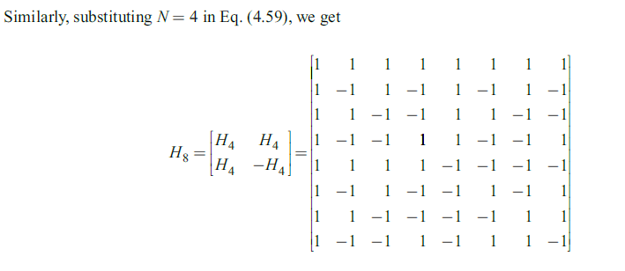

Slide 54
Hadamard Transform
Hadamard of Sequence
X[n]={H(N).x(n)}
Inverse Hadamard of Sequence
X[n] = 1/N{H(N).x(n)}
Hadamard of image (2D)
Hadamard is symmetric transform
F = TfT

Slide 55
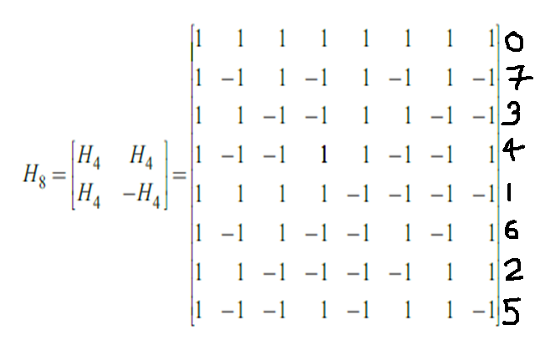
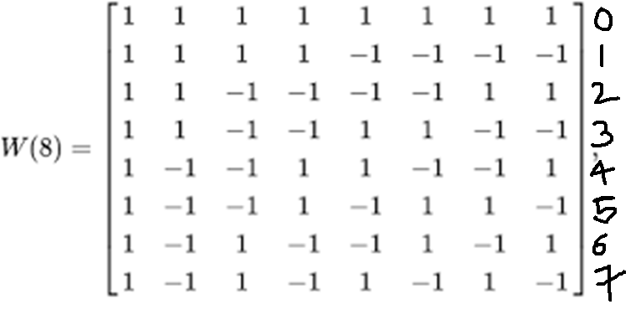

Slide 56
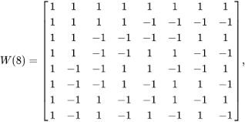
Walsh Transform

Slide 57
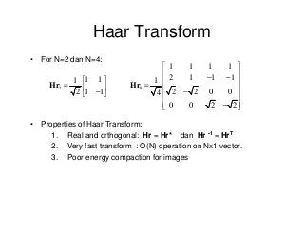
Haar Transform

Slide 58
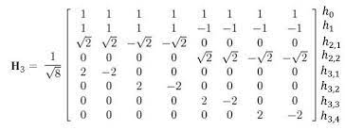
Haar Transform

Slide 59
IMAGE ENHANCEMENT IN THE FREQUENCY DOMAIN
If we multiply each element of the Fourier coefficient by a suitably chosen weighting function then we can accentuate certain frequency components and attenuate others.
This selective enhancement or suppression of frequency components is termed Fourier filtering or frequency domain filtering.
The spatial representation of image data describes the adjacency relationship between the pixels.
On the other hand, the frequency domain representation clusters the image data according to their frequency distribution.
In frequency domain filtering, the image data is dissected into various spectral bands, where each band depicts a specific range of details within the image.
The process of selective frequency inclusion or exclusion is termed frequency domain filtering.
It is possible to perform filtering in the frequency domain by specifying the frequencies that should be kept and the frequencies that should be discarded.

Slide 60
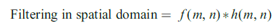
IMAGE ENHANCEMENT IN THE FREQUENCY DOMAIN
f(m,n) – original image
F(k,l) – FT of original image
h(m,n) – Filtering mask
H(k,l) – FT of filtering mask

Slide 61
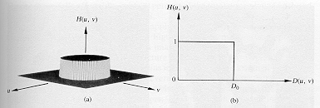


Low-pass (LP) filtering
Preserves low frequencies, attenuates high frequencies.
ideal
in practice
D₀: cut-off frequency

Slide 62
Lowpass (LP) filtering (cont’d)
In 2D, the cutoff frequencies lie on a circle.

Slide 63
Low-pass (LP) filtering
D0 is the cut-off frequency of the low-pass filter.
The cut-off frequency determines the amount of frequency components passed by the filter.
The smaller the value of D0 , the greater the number of image components eliminated by the filter.
The value of D0 is chosen in such a way that the components of interest are passed through.

Slide 64

How does D₀ control smoothing? (cont’d)
D₀ controls the amount of blurring
r=78 (99%)
r=8 (90%)

Slide 65


Ringing Effect
Sharp cutoff frequencies produce an overshoot of image features whose frequency is close to the cutoff frequencies (ringing effect).
h=f*g

Slide 66
Low Pass (LP) Filters
Ideal low-pass filter (ILPF)
Butterworth low-pass filter (BLPF)
Gaussian low-pass filter (GLPF)

Slide 67


Slide 68

Butterworth LP filter (BLPF)
In practice, we use filters that attenuate high frequencies smoothly (e.g., Butterworth LP filter) → less ringing effect
n=1
n=4
n=16

Slide 69
Spatial Representation of BLPFs
n=1 n=2 n=5 n=20

Slide 70

Comparison: Ideal LP and BLPF
ILPF
BLPF
D₀=10, 30,
60, 160,
460
D₀=10, 30,
60, 160,
460
n=2

Slide 71
Gaussian LP filter (GLPF)
Notes:
71

Slide 72
Example: smoothing by GLPF (1)

Slide 73

Examples of smoothing by GLPF (2)
D₀=100
D₀=80

Slide 74

High-Pass filtering
A high-pass filter can be obtained from a low-pass filter using:
= 1 -
D₀

Slide 75
High-pass filtering (cont’d)
Preserves high frequencies, attenuates low frequencies.

Slide 76

Butterworth high pass filter (BHPF)
In practice, we use filters that attenuate low frequencies smoothly (e.g., Butterworth HP filter) → less ringing effect

Slide 77


Comparison: IHPF and BHPF
IHPF
D₀=30,60,160
D₀=30,60,160
BHPF
n=2

Slide 78

Gaussian HP filter
GHPF
BHPF

Slide 79

Comparison: BHPF and GHPF
BHPF
D₀=30,60,160
n=2
D₀=30,60,160
GHPF

Slide 80

Homomorphic filtering
Many times, we want to remove shading effects from an image (i.e., due to uneven illumination)
Enhance high frequencies
Attenuate low frequencies but preserve fine detail.

Slide 81
Homomorphic Filtering (cont’d)
Consider the following model of image formation:
In general, the illumination component i(x,y) varies slowly and affects low frequencies mostly.
In general, the reflection component r(x,y) varies faster and affects high frequencies mostly.
i(x,y): illumination
r(x,y): reflection
IDEA: separate low frequencies due to i(x,y)
from high frequencies due to r(x,y)

Slide 82
How are frequencies mixed together?
Low and high frequencies from i(x,y) and r(x,y)
are mixed together.
When applying filtering, it is difficult to handle
low/high frequencies separately.

Slide 83
Can we separate them?
Idea:
Take the ln( ) of

Slide 84
Steps of Homomorphic Filtering
(1) Take
(2) Apply FT:
or
(3) Apply H(u,v)

Slide 85


Steps of Homomorphic Filtering (cont’d)
(4) Take Inverse FT:
or
(5) Take exp( ) or

Slide 86
Example using high-frequency emphasis
Attenuate the contribution made by illumination and amplify the contribution made by reflectance
Attenuate the contribution made by illumination and amplify the contribution made by reflectance

Slide 87
Homomorphic Filtering: Example

Slide 88
Homomorphic Filtering: Example

Slide 89
Karhren Loeve Transform (Hotelling Transfrom)
Also called as Eigen Vector Transform.
Based on statistical properties of image and has several important properties that make it useful for image processing – image compression.
Data from neighbouring pixels is highly correlated , so achieving image compression without losing the quality of image is a challenge.

Slide 90
Karhren Loeve Transform (Hotelling Transfrom)
By de-correlating this data more compression can be achieved.
KL transform de-correlates the data which facilitates high degrees of compression

Slide 91

Steps to compute KL transform

Slide 92


Slide 93


Slide 94


Slide 95


Slide 96

Eigen Value

Slide 98


Slide 99


Slide 100


Slide 101



Slide 102


Slide 103


